Slide 1
Introduction to HTML Part 1
Svetlin Nakov
National Academy for Software Development
academy.devbg.org
Notes:
*
07/16/96
(c) 2007 National Academy for Software Development - http://academy.devbg.org. All rights reserved. Unauthorized copying or re-distribution is strictly prohibited.*
<number>##

Slide 2
Contents
Introduction to HTML
  How the Web Works?
  What is a Web Page?
  My First HTML Page
  Basic Tags: Hyperlinks, Images, Formatting
  Headings and Paragraphs
HTML in Details
  The <!DOCTYPE> Declaration

Slide 3
Contents (2)
  The <head> Section: Title, Meta, Script, Style
  The <body> Section
  Text Styling and Formatting Tags
  Hyperlinks: <a> Tag
  Hyperlinks and Sections
  Images: <img> tag
  Lists: <ol> and <ul> Tag
  HTML Special Characters
The <div> and <span> Tags

Slide 4



How the Web Works?
Client/server architecture
HTTP
Page request
HTTP
Server response
Client running Web Browser
Server running Web Server Software (Apache, IIS, etc.)
Notes:
*
07/16/96
(c) 2007 National Academy for Software Development - http://academy.devbg.org. All rights reserved. Unauthorized copying or re-distribution is strictly prohibited.*
<number>##

Slide 5
What is a Web Page?
A text file containing HTML
HTML – Hyper Text Markup Language
A system for describing
  document structure (semantic markup)
  formatting (presentation markup)
Looks like:
  A Microsoft Word document
The markup tags tell the Web browser how to display the page
Notes:
*
07/16/96
(c) 2007 National Academy for Software Development - http://academy.devbg.org. All rights reserved. Unauthorized copying or re-distribution is strictly prohibited.*
<number>##

Slide 6
Creating HTML Pages
An HTML file must have an .htm or .html file extension
Text Editors:
  NotePad
  UltraEdit
  NotePad ++
HTML Editors (WYSIWYG Editors):
  Microsoft FrontPage
  Macromedia Dreamweaver
  Netscape Composer
  Microsoft Word
Notes:
*
07/16/96
(c) 2007 National Academy for Software Development - http://academy.devbg.org. All rights reserved. Unauthorized copying or re-distribution is strictly prohibited.*
<number>##

Slide 7
Introduction to HTML
Your First HTML Page
Notes:
*
07/16/96
(c) 2007 National Academy for Software Development - http://academy.devbg.org. All rights reserved. Unauthorized copying or re-distribution is strictly prohibited.*
<number>##

Slide 8
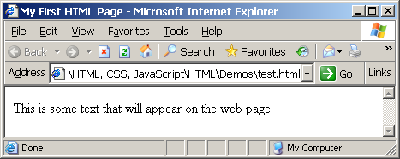
My First HTML Page
test.html
<html>
<head>
<title>My First HTML Page</title>
</head>
<body>
This is some text that will
appear on the web page.
</body>
</html>
Notes:
*
07/16/96
(c) 2007 National Academy for Software Development - http://academy.devbg.org. All rights reserved. Unauthorized copying or re-distribution is strictly prohibited.*
<number>##

Slide 9
My First HTML Page
Live Demo
Notes:
*
07/16/96
(c) 2007 National Academy for Software Development - http://academy.devbg.org. All rights reserved. Unauthorized copying or re-distribution is strictly prohibited.*
<number>##

Slide 10
My First HTML Page
Opening Tag
<html>
<head>
<title>My First HTML Page</title>
</head>
<body>
This is some text that will
appear on the web page.
</body>
</html>
Closing Tag
Notes:
*
07/16/96
(c) 2007 National Academy for Software Development - http://academy.devbg.org. All rights reserved. Unauthorized copying or re-distribution is strictly prohibited.*
<number>##

Slide 11
My First HTML Page
HTML Header
<html>
<head>
<title>My First HTML Page</title>
</head>
<body>
This is some text that will
appear on the web page.
</body>
</html>
Notes:
*
07/16/96
(c) 2007 National Academy for Software Development - http://academy.devbg.org. All rights reserved. Unauthorized copying or re-distribution is strictly prohibited.*
<number>##

Slide 12
My First HTML Page
HTML Body
<html>
<head>
<title>My First HTML Page</title>
</head>
<body>
This is some text that will
appear on the web page.
</body>
</html>
Notes:
*
07/16/96
(c) 2007 National Academy for Software Development - http://academy.devbg.org. All rights reserved. Unauthorized copying or re-distribution is strictly prohibited.*
<number>##

Slide 13
Introduction to HTML
Some Basic HTML Tags
Notes:
*
07/16/96
(c) 2007 National Academy for Software Development - http://academy.devbg.org. All rights reserved. Unauthorized copying or re-distribution is strictly prohibited.*
<number>##

Slide 14
More About Tags
Hyperlink Tags
Image Tags
Formatting tags
<a href="http://www.devbg.org/"
title="BASD">Link to some URL</a>
<img src="logo.gif" alt="logo" />
<b>This text is bold</b>
And this is <u>underlined</u>
<center>Some centered text</center>
Notes:
*
07/16/96
(c) 2007 National Academy for Software Development - http://academy.devbg.org. All rights reserved. Unauthorized copying or re-distribution is strictly prohibited.*
<number>##

Slide 15
Some Tags – Example
some-tags.html
<html>
<body>
<a href="http://www.devbg.org/" title=
"BASD">This is a link to some URL</a>
<br />
<img src="logo.gif" alt="logo" />
<br />
<b>This text is bold</b>
<br />
And this is <u>underlined</u>
<br />
<center>Some centered text</center>
</body>
</html>
Notes:
*
07/16/96
(c) 2007 National Academy for Software Development - http://academy.devbg.org. All rights reserved. Unauthorized copying or re-distribution is strictly prohibited.*
<number>##

Slide 16
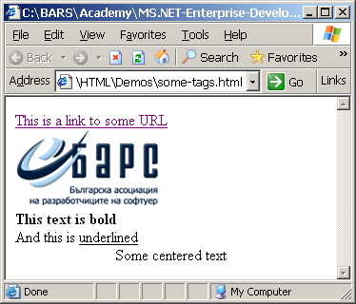
Some Tags – Example
some-tags.html
<html>
<body>
<a href="http://www.devbg.org/" title=
"BASD">This is a link to some URL</a>
<br />
<img src="logo.gif" alt="logo" />
<br />
<b>This text is bold</b>
<br />
And this is <u>underlined</u>
<br />
<center>Some centered text</center>
</body>
</html>
Notes:
*
07/16/96
(c) 2007 National Academy for Software Development - http://academy.devbg.org. All rights reserved. Unauthorized copying or re-distribution is strictly prohibited.*
<number>##

Slide 17
Some HTML Tags
Live Demo
Notes:
*
07/16/96
(c) 2007 National Academy for Software Development - http://academy.devbg.org. All rights reserved. Unauthorized copying or re-distribution is strictly prohibited.*
<number>##

Slide 18
Tags Attributes
Every tag has attributes that specify their properties and behavior
  There are few attributes that apply to every element: id, style, class, title
    There cannot be two elements in one document with same id
    Content of title attribute is displayed as hint when element is hovered with mouse
    Some elements have obligatory attributes
Source attribute of <img> tag
Alternative text
<img src="logo.gif" alt="logo" />

Slide 19
Headings and Paragraphs
Heading Tags
Paragraph Tags
Sections: div and span tags
<h1>Heading 1</h1>
<h2>Sub heading 2</h2>
<h3>Sub heading 3</h3>
<p>This is my first paragraph</p>
<p>This is my second paragraph</p>
<div align="center" style=
"background: skyblue">This is a div</div>
Notes:
*
07/16/96
(c) 2007 National Academy for Software Development - http://academy.devbg.org. All rights reserved. Unauthorized copying or re-distribution is strictly prohibited.*
<number>##

Slide 20
Headings and Paragraphs – Example
headings.html
<html>
<head><title>Headings and
paragraphs</title></head>
<body>
<h1>Heading 1</h1>
<h2>Sub heading 2</h2>
<h3>Sub heading 3</h3>
<p>This is my first paragraph</p>
<p>This is my second paragraph</p>
<div align="center"
style="background:skyblue">
This is a div</div>
</body>
</html>

Slide 21
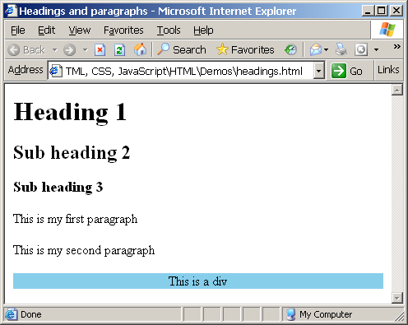
Headings and Paragraphs – Example
headings.html
<html>
<head><title>Headings and
paragraphs</title></head>
<body>
<h1>Heading 1</h1>
<h2>Sub heading 2</h2>
<h3>Sub heading 3</h3>
<p>This is my first paragraph</p>
<p>This is my second paragraph</p>
<div align="center"
style="background:skyblue">
This is a div</div>
</body>
</html>

Slide 22
Headings and Paragraphs
Live Demo
Notes:
*
07/16/96
(c) 2007 National Academy for Software Development - http://academy.devbg.org. All rights reserved. Unauthorized copying or re-distribution is strictly prohibited.*
<number>##

Slide 23
Introduction to HTML
HTML In Depth
Notes:
*
07/16/96
(c) 2007 National Academy for Software Development - http://academy.devbg.org. All rights reserved. Unauthorized copying or re-distribution is strictly prohibited.*
<number>##

Slide 24
The <!doctype> Declaration
Beginning of HTML document must have a document type declaration
  It tells Web browsers how to handle the version of HTML you are writing
  Possible versions: HTML 2.0, HTML 3.2, HTML 4.01, XHTML 1.0, XHTML 1.1
Example:
See http://www.w3.org/QA/2002/04/Web-Quality for a list of possible doctypes
<!DOCTYPE html PUBLIC "-//W3C//DTD XHTML 1.0 Transitional//EN" "http://www.w3.org/TR/xhtml1/DTD/xhtml1-transitional.dtd">
Notes:
*
07/16/96
(c) 2007 National Academy for Software Development - http://academy.devbg.org. All rights reserved. Unauthorized copying or re-distribution is strictly prohibited.*
<number>##

Slide 25
DOCTYPE Subtypes
HTML and XHTML split into three major versions – Strict, Transitional, Frameset
  XHTML 1.0 Strict – Really clean markup, free of presentation clutter, must be used with CSS
  XHTML 1.0 Transitional – Provides some HTML’s presentation features, useful for support of browsers that don’t understand CSS
  XHTML 1.0 Frameset – Enables partitioning of browser window in frames

Slide 26
HTML vs. XHTML
XHTML is more strict
  All tags must be properly nested (HTML allows <b><i>text</b></i>)
  All tags and attribute names must be written in lower case, attribute values must be in " " (HTML allows ' ')
  All tags must be closed (<br/>, <img/>) while HTML allows <br> and <img>
  XHTML allows only one root <html> element (HTML allows more than one)

Slide 27
XHTML vs. HTML (2)
Many element attributes are deprecated in XHTML, most are moved to CSS
Attribute minimization is forbidden
  Example: <input type="checkbox" checked>
  Becomes: <input type="checkbox" checked="checked" />
Browsers load XHTML faster than HTML and valid code faster than invalid

Slide 28
HTML Basics
HTML is comprised of elements called “tags”
  Begins with <html> and ends with </html>
  When writing XHTML, must define a namespace
Tags are nested:
Tags have attributes
HTML describes structure using two main sections: <head> and <body>
<html xmlns="http://www.w3.org/1999/xhtml">
<html> <head></head> <body></body> </html>
<img src="logo.jpg" alt="logo" />
Notes:
*
07/16/96
(c) 2007 National Academy for Software Development - http://academy.devbg.org. All rights reserved. Unauthorized copying or re-distribution is strictly prohibited.*
<number>##

Slide 29
<head> Section: Introduction
Contains information that doesn’t show directly on the viewable page
Starts after the <!doctype> declaration
Begins with <head> and ends with </head>
Contains mandatory single <title> tag
Can contain multiple nested tags, e. g.:
  <meta>
  <script>
  <style>
  <!– comments -->
Notes:
*
07/16/96
(c) 2007 National Academy for Software Development - http://academy.devbg.org. All rights reserved. Unauthorized copying or re-distribution is strictly prohibited.*
<number>##

Slide 30

<head> Section: <title> tag
Exists between <head> </head> tags
<title>ENTP 395: Web Development (Summer 2005)</title>
Use to give the Web page a title
Search engines and people rely on titles
Notes:
*
07/16/96
(c) 2007 National Academy for Software Development - http://academy.devbg.org. All rights reserved. Unauthorized copying or re-distribution is strictly prohibited.*
<number>##

Slide 31
<head> Section: <meta>
Meta tags additionally describe the content contained within the page
<meta name="description" content="HTML tutorial">
<meta name="keywords" content="html, web design, styles">
<meta name="author" content="Chris Brewer">
<meta http-equiv="refresh" content="5; url=http://www.fogbox.com">
Notes:
*
07/16/96
(c) 2007 National Academy for Software Development - http://academy.devbg.org. All rights reserved. Unauthorized copying or re-distribution is strictly prohibited.*
<number>##

Slide 32
<head> Section: <script>
The <script> </script> tag is used to embed scripts into an HTML document
Script are executed in the client's Web browser
Supported client-side scripting languages:
  JavaScript (it is not Java!)
  VBScript
  JScript
Notes:
*
07/16/96
(c) 2007 National Academy for Software Development - http://academy.devbg.org. All rights reserved. Unauthorized copying or re-distribution is strictly prohibited.*
<number>##

Slide 33
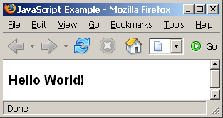
<script> – Example
<html>
<head>
<title>JavaScript Example</title>
<script type="text/javascript">
function sayHello() {
document.write(
"<p><b>Hello World!<\/b>");
}
</script>
</head>
<body>
<script type=
"text/javascript">
sayHello();
</script>
</body>
</html>
scripts-example.html

Slide 34
Using Scripts
Live Demo
Notes:
*
07/16/96
(c) 2007 National Academy for Software Development - http://academy.devbg.org. All rights reserved. Unauthorized copying or re-distribution is strictly prohibited.*
<number>##

Slide 35
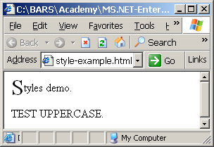
<head> Section: <style>
The <style> </style> tag embeds formatting information (CSS styles) into a HTML page
style-example.html
<html>
<head>
<style type="text/css">
p { font-size: 12pt; line-height: 12pt }
p:first-letter { font-size: 200%; float: left }
span { text-transform: uppercase }
</style>
</head>
<body>
<p>Styles demo.</p>
<span>Test uppercase</span>.
</body>
</html>
Notes:
*
07/16/96
(c) 2007 National Academy for Software Development - http://academy.devbg.org. All rights reserved. Unauthorized copying or re-distribution is strictly prohibited.*
<number>##

Slide 36
Embedding CSS Styles
Live Demo
Notes:
*
07/16/96
(c) 2007 National Academy for Software Development - http://academy.devbg.org. All rights reserved. Unauthorized copying or re-distribution is strictly prohibited.*
<number>##

Slide 37
Comments: <!-- --> Tag
Comments are a developer’s best friends
Comments can exist anywhere between the <html></html> tags
Comments start with <!-- and end with -->
<!–- BASD Logo (It is a GIF file with transparent background) -->
<img src="logo.gif" alt="BASD Logo">
<!–- Hyperlink to BASD official Web site -->
<a href="http://www.devbg.org/">BASD Home</a>
<!–- Show the news table -->
<table class="newstable">
...
Notes:
*
07/16/96
(c) 2007 National Academy for Software Development - http://academy.devbg.org. All rights reserved. Unauthorized copying or re-distribution is strictly prohibited.*
<number>##

Slide 38
<body> Section: Introduction
The <body> section describes the viewable portion of the page
Starts after the <head> </head> section
Begins with <body> and ends with </body>
<html>
<head><title>Test page</title></head>
<body>
This is the Web page body!
</body>
</html>
Notes:
*
07/16/96
(c) 2007 National Academy for Software Development - http://academy.devbg.org. All rights reserved. Unauthorized copying or re-distribution is strictly prohibited.*
<number>##

Slide 39
<body> Section: Attributes
All tags have attributes
For example, <body> tag has following attributes:
Example:
background | Background image file | ="URL"
bgcolor | Background color | ="color"
text | Default text color | ="color"
link | Hyperlink color | ="color"
vlink | Visited hyperlink color | ="color"
<body background="texture.gif" text="#238E23">
* For color codes, see www.webreference.com/html/tools/colorizer/
Notes:
*
07/16/96
(c) 2007 National Academy for Software Development - http://academy.devbg.org. All rights reserved. Unauthorized copying or re-distribution is strictly prohibited.*
<number>##

Slide 40
Text Styling without CSS
Text can be formatted as headings or regular paragraph text
  Use these consistently!
<p></p> by default double spaces after each paragraph
<br /> is weird: the trailing “/” makes it XHTML compliant
Different styles of heading are available
<h1></h1> | Heading 1
<h2></h2> | Heading 2
<h3></h3> | Heading 3
<h4></h4> | Heading 4
<h5></h5> | Heading 5
<h6></h6> | Heading 6
<p></p> | Paragraph
<br /> | Line break
Notes:
*
07/16/96
(c) 2007 National Academy for Software Development - http://academy.devbg.org. All rights reserved. Unauthorized copying or re-distribution is strictly prohibited.*
<number>##

Slide 41
Text Formatting
Tags modify the text between the opening tag and the closing tag
  Ex. <b>Hello</b> makes “Hello” bold
<b></b> | bold
<i></i> | italicized
<u></u> | underlined
<sup></sup> | Sample^{superscript}
<sub></sub> | Sample_{subscript}
<strong></strong> | strong
<em></em> | emphasized
<pre></pre> | Preformatted text
<blockquote></blockquote> | Quoted text block
<del></del> | Deleted text –
Notes:
*
07/16/96
(c) 2007 National Academy for Software Development - http://academy.devbg.org. All rights reserved. Unauthorized copying or re-distribution is strictly prohibited.*
<number>##

Slide 42
Text Formatting – Example
text-formatting.html
<!DOCTYPE html PUBLIC
"-//W3C//DTD XHTML 1.0 Transitional//EN"
"http://www.w3.org/TR/xhtml1/DTD/xhtml1-transitional.dtd">
<html>
<head>
<title>Svetlin Nakov</title>
</head>
<body bgcolor="black" text="white" link="red" vlink="blue">
<h1>Notice</h1>
<p>This is a <em>sample</em> Web page.</p>
<p><pre>Next paragraph:
preformatted.</pre></p>
<h2>More Info</h2>
<p>Specifically, we’re using XHMTL 1.0 transitional.<br>
Next line.</p>
</body>
</html>
Notes:
*
07/16/96
(c) 2007 National Academy for Software Development - http://academy.devbg.org. All rights reserved. Unauthorized copying or re-distribution is strictly prohibited.*
<number>##

Slide 43
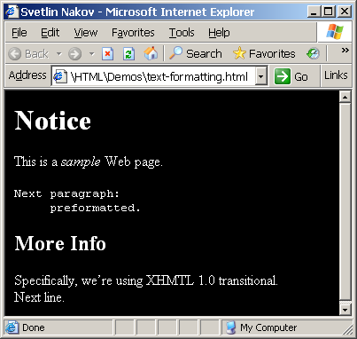
Text Formatting – Example
text-formatting.html
<!DOCTYPE html PUBLIC
"-//W3C//DTD XHTML 1.0 Transitional//EN"
"http://www.w3.org/TR/xhtml1/DTD/xhtml1-transitional.dtd">
<html>
<head>
<title>Svetlin Nakov</title>
</head>
<body bgcolor="black" text="white" link="red" vlink="blue">
<h1>Notice</h1>
<p>This is a <em>sample</em> Web page.</p>
<p><pre>Next paragraph:
preformatted.</pre></p>
<h2>More Info</h2>
<p>Specifically, we’re using XHMTL 1.0 transitional.<br>
Next line.</p>
</body>
</html>
Notes:
*
07/16/96
(c) 2007 National Academy for Software Development - http://academy.devbg.org. All rights reserved. Unauthorized copying or re-distribution is strictly prohibited.*
<number>##

Slide 44
Text Formatting
Live Demo
Notes:
*
07/16/96
(c) 2007 National Academy for Software Development - http://academy.devbg.org. All rights reserved. Unauthorized copying or re-distribution is strictly prohibited.*
<number>##

Slide 45
Hyperlinks: <a> Tag
Link to a document called form.html on the same server in the same directory:
Link to a document called parent.html on the same server in the parent directory:
Link to a document called cat.html on the same server in the subdirectory stuff:
<a href="form.html">Fill Our Form</a>
<a href="../parent.html">Parent</a>
<a href="stuff/cat.html">Catalog</a>
Notes:
*
07/16/96
(c) 2007 National Academy for Software Development - http://academy.devbg.org. All rights reserved. Unauthorized copying or re-distribution is strictly prohibited.*
<number>##

Slide 46
Hyperlinks: <a> Tag (2)
Link to an external Web site:
  Always use a full URL, including "http://"
  Using the target="_blank" attribute opens the link in a new window
Link to an E-mail address:
<a href="http://www.devbg.org" target="_blank">BASD</a>
<a href="mailto:bugs@example.com?subject= Bug Report">Please report bugs here (by e-mail only)</a>
Notes:
*
07/16/96
(c) 2007 National Academy for Software Development - http://academy.devbg.org. All rights reserved. Unauthorized copying or re-distribution is strictly prohibited.*
<number>##

Slide 47
Hyperlinks: <a> Tag (3)
Link to a document called apply-now.html on the same server in same directory using an image as a button:
Link to a document called index.html on the same server in the subdirectory english of the parent directory:
<a href="apply-now.html"><img
src="apply-now-button.jpg" /></a>
<a href="../english/index.html">Switch to English version</a>
Notes:
*
07/16/96
(c) 2007 National Academy for Software Development - http://academy.devbg.org. All rights reserved. Unauthorized copying or re-distribution is strictly prohibited.*
<number>##

Slide 48
Hyperlinks and Sections
Link to another location in the same document:
Link to a specific location in another document:
<a href="#section1">Go to Introduction</a>
...
<a name="section1">Introduction</a>
<a href="chapter3.html#section3.1.1">Go to Section 3.1.1</a>
<!–- In chapter3.html -->
...
<a name="section3.1.1">
<h3>3.1.1. Technical Background</h3>
</a>

Slide 49
Hyperlinks – Example
hyperlinks.html
<a href="form.html">Fill Our Form</a> <br/>
<a href="../parent.html">Parent</a> <br/>
<a href="stuff/cat.html">Catalog</a> <br/>
<a href="http://www.devbg.org" target="_blank">BASD</a> <br/>
<a href="mailto:bugs@example.com?subject= Bug Report">Please report bugs here (by e-mail only)</a> <br/>
<a href="apply-now.html"><img src="apply-now-button.jpg" border="0"/></a> <br/>
<a href="../english/index.html">Switch to English version</a> <br/>

Slide 50
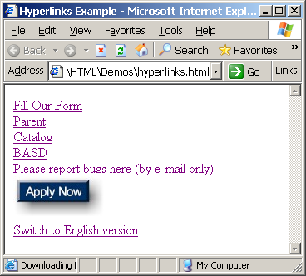
Hyperlinks – Example
hyperlinks.html
<a href="form.html">Fill Our Form</a> <br/>
<a href="../parent.html">Parent</a> <br/>
<a href="stuff/cat.html">Catalog</a> <br/>
<a href="http://www.devbg.org" target="_blank">BASD</a> <br/>
<a href="mailto:bugs@example.com?subject= Bug Report">Please report bugs here (by e-mail only)</a> <br/>
<a href="apply-now.html"><img src="apply-now-button.jpg" border="0"/></a> <br/>
<a href="../english/index.html">Switch to English version</a> <br/>

Slide 51
Hyperlinks
Live Demo
Notes:
*
07/16/96
(c) 2007 National Academy for Software Development - http://academy.devbg.org. All rights reserved. Unauthorized copying or re-distribution is strictly prohibited.*
<number>##

Slide 52
Links to the Same Document – Example
links-to-same-document.html
<h1>Table of Contents</h1>
<p><a href="#section1">Introduction</a><br/>
<a href="#section2">Some background</A><br/>
<a href="#section2.1">Project History</a><br/>
...the rest of the table of contents...
<!-- The document text follows here -->
<h2><a name="section1">Introduction</a></h2>
... Section 1 follows here ...
<h2><a name="section2">Some background</a></h2>
... Section 2 follows here ...
<h3><a name="section2.1">Project History</a></h3>
... Section 2.1 follows here ...

Slide 53
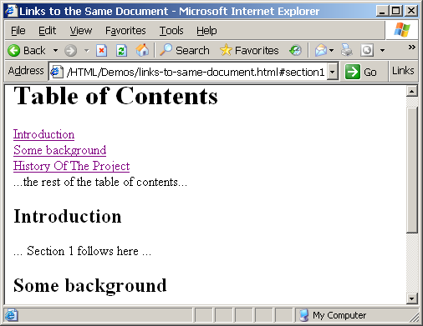
Links to the Same Document – Example
links-to-same-document.html
<h1>Table of Contents</h1>
<p><a href="#section1">Introduction</a><br/>
<a href="#section2">Some background</A><br/>
<a href="#section2.1">Project History</a><br/>
...the rest of the table of contents...
<!-- The document text follows here -->
<h2><a name="section1">Introduction</a></h2>
... Section 1 follows here ...
<h2><a name="section2">Some background</a></h2>
... Section 2 follows here ...
<h3><a name="section2.1">Project History</a></h3>
... Section 2.1 follows here ...

Slide 54
Links to the Same Document
Live Demo
Notes:
*
07/16/96
(c) 2007 National Academy for Software Development - http://academy.devbg.org. All rights reserved. Unauthorized copying or re-distribution is strictly prohibited.*
<number>##

Slide 55
Images: <img> tag
Add an image:
There are a number of attributes:
Example:
<img src="/img/basd-logo.png">
src | Location of image file (relative or absolute)
alt | Substitute text for display (e.g. in text mode)
align | Text alignment: bottom, middle, top
height | Number of pixels of the height
width | Number of pixels of the width
border | Size of border, 0 for no border
<img src="./php-logo.png" alt="PHP logo" border="0">
Notes:
*
07/16/96
(c) 2007 National Academy for Software Development - http://academy.devbg.org. All rights reserved. Unauthorized copying or re-distribution is strictly prohibited.*
<number>##

Slide 56
Miscellaneous Tags
<hr />: Draws a horizontal rule (line):
<center></center>: Deprecated!
<font>: Changes typestyle. With CSS, there is no reason to use this tag:
<hr size="5" width="70%" />
<center>Hello World!</center>
<font size="3" color="blue">Font3</font>
<font size="+4" color="blue">Font+4</font>
Notes:
*
07/16/96
(c) 2007 National Academy for Software Development - http://academy.devbg.org. All rights reserved. Unauthorized copying or re-distribution is strictly prohibited.*
<number>##

Slide 57
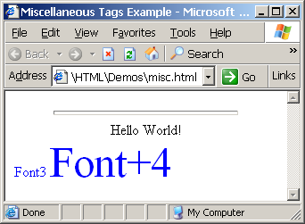
Misc. Tags – Example
misc.html
<html>
<head>
<title>Miscellaneous Tags Example</title>
</head>
<body>
<hr size="5" width="70%" />
<center>Hello World!</center>
<font size="3" color="blue">Font3</font>
<font size="+4" color="blue">Font+4</font>
</body>
</html>

Slide 58
Miscellaneous Tags
Live Demo
Notes:
*
07/16/96
(c) 2007 National Academy for Software Development - http://academy.devbg.org. All rights reserved. Unauthorized copying or re-distribution is strictly prohibited.*
<number>##

Slide 59
Ordered Lists: <ol> Tag
Create an Ordered List using <ol></ol>
Attribute values for type are 1, A, a, I, or i
<ol type="1">
<li>Apple</li>
<li>Orange</li>
<li>Grapefruit</li>
</ol>
Apple
Orange
Grapefruit
Apple
Orange
Grapefruit
Apple
Orange
Grapefruit
Apple
Orange
Grapefruit
Apple
Orange
Grapefruit
Notes:
*
07/16/96
(c) 2007 National Academy for Software Development - http://academy.devbg.org. All rights reserved. Unauthorized copying or re-distribution is strictly prohibited.*
<number>##

Slide 60
Unordered Lists: <ul> Tag
Create an Unordered List using <ul></ul>
Attribute values for type are disc, square or circle
<ul type="disk">
<li>Apple</li>
<li>Orange</li>
<li>Grapefruit</li>
</ul>
Apple
Orange
Pear
Apple
Orange
Pear
Apple
Orange
Pear
Notes:
*
07/16/96
(c) 2007 National Academy for Software Development - http://academy.devbg.org. All rights reserved. Unauthorized copying or re-distribution is strictly prohibited.*
<number>##

Slide 61
Definition lists: <dl> tag
Create definition lists using <dl>
  Pairs of text and associated definition; text is in <dt> tag, definition in <dd> tag
  Renders without bullets. Definition is indented
<dl>
  <dt>HTML</dt>
  <dd>A markup language …</dd>
  <dt>CSS</dt>
  <dd>Language used to …</dd>
</dl>

Slide 62
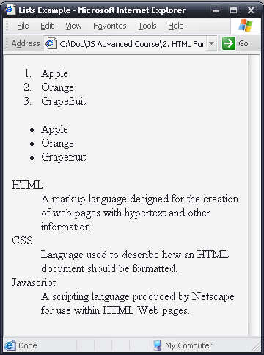
Lists – Example
<html>
<body>
<ol type="1">
<li>Apple</li>
<li>Orange</li>
<li>Grapefruit</li>
</ol>
<ul type="disc">
<li>Apple</li>
<li>Orange</li>
<li>Grapefruit</li>
</ul>
<dl>
<dt>HTML</dt>
<dd>A markup language…</dd>
</dl>
</body>
</html>
lists.html

Slide 63
Creating Lists
Live Demo
Notes:
*
07/16/96
(c) 2007 National Academy for Software Development - http://academy.devbg.org. All rights reserved. Unauthorized copying or re-distribution is strictly prohibited.*
<number>##

Slide 64
HTML Special Characters
Symbol Name
HTML Entity
Symbol
Copyright Sign
&copy;
©
Registered Trademark Sign
&reg;
®
Trademark Sign
&trade;
™
Less Than
&lt;
<
Greater Than
&gt;
>
Ampersand
&amp;
&
Non-breaking Space
&nbsp;
Em Dash
&mdash;
—
Quotation Mark
&quot;
"
Euro
&#8364;
€
British Pound
&pound;
£
Japanese Yen
&yen;
¥
Notes:
*
07/16/96
(c) 2007 National Academy for Software Development - http://academy.devbg.org. All rights reserved. Unauthorized copying or re-distribution is strictly prohibited.*
<number>##

Slide 65
Special Chars – Example
<html>
<head>
<title>Special HTML Characters Example</title>
</head>
<body>
<p>[&gt;&gt;&nbsp;&nbsp;Welcome
&nbsp;&nbsp;&lt;&lt;]</p>
<p>&#9658;I have following cards:
A&#9827;, K&#9830; and 9&#9829;.</p>
<p>&#9658;I prefer hard rock &#9835;
music &#9835;</p>
<p>© 2006 by Svetlin Nakov &amp;
Martin Kulov,</p>
<p>National Academy for Software Development™</p>
</body>
</html>
special-chars.html

Slide 66
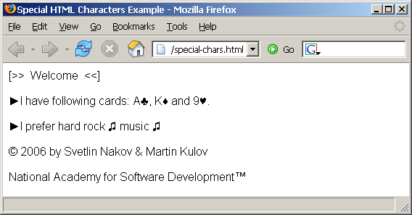
Special Chars – Example
<html>
<head>
<title>Special HTML Characters Example</title>
</head>
<body>
<p>[&gt;&gt;&nbsp;&nbsp;Welcome
&nbsp;&nbsp;&lt;&lt;]</p>
<p>&#9658;I have following cards:
A&#9827;, K&#9830; and 9&#9829;.</p>
<p>&#9658;I prefer hard rock &#9835;
music &#9835;</p>
<p>© 2006 by Svetlin Nakov &amp;
Martin Kulov,</p>
<p>National Academy for Software Development™</p>
</body>
</html>
special-chars.html

Slide 67
HTML Special Characters
Live Demo
Notes:
*
07/16/96
(c) 2007 National Academy for Software Development - http://academy.devbg.org. All rights reserved. Unauthorized copying or re-distribution is strictly prohibited.*
<number>##

Slide 68
Using <DIV> And <SPAN>
Block And Inline elements
Notes:
*
07/16/96
(c) 2007 National Academy for Software Development - http://academy.devbg.org. All rights reserved. Unauthorized copying or re-distribution is strictly prohibited.*
<number>##

Slide 69
Block And Inline Elements
“Block” elements because they act as if there is break before and after them
  <div> is a block element
  Other block elements are <table>, <hr>, headings, lists, <center>, <p> and etc.
“Inline” elements don’t break the text before and after them
  <span> is inline element
  Most HTML elements are inline, e.g. <a>

Slide 70
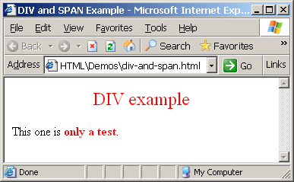
The <div> Tag
Creates logical divisions within a page
Block style
element
Used with CSS
Example:
div-and-span.html
<div align="center" style="font-size:24; color:red">DIV example</div>
<p>This one is <span style="color:red; font-weight:bold">only a test</span>.</p>
Notes:
*
07/16/96
(c) 2007 National Academy for Software Development - http://academy.devbg.org. All rights reserved. Unauthorized copying or re-distribution is strictly prohibited.*
<number>##

Slide 71
<DIV>
Live Demo
Notes:
*
07/16/96
(c) 2007 National Academy for Software Development - http://academy.devbg.org. All rights reserved. Unauthorized copying or re-distribution is strictly prohibited.*
<number>##

Slide 72
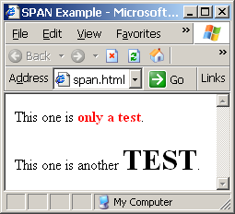
The <span> Tag
Inline style element
Useful for modifying a specific portion of text without creating a separate division (paragraph) in the document
Very useful with CSS
span.html
<p>This one is <span style="color:red; font-weight:bold">only a test</span>.</p>
<p>This one is another <span style="font-size:32; font-weight:bold">TEST</span>.</p>
Notes:
*
07/16/96
(c) 2007 National Academy for Software Development - http://academy.devbg.org. All rights reserved. Unauthorized copying or re-distribution is strictly prohibited.*
<number>##

Slide 73
<SPAN>
Live Demo
Notes:
*
07/16/96
(c) 2007 National Academy for Software Development - http://academy.devbg.org. All rights reserved. Unauthorized copying or re-distribution is strictly prohibited.*
<number>##

Slide 74
Questions?
Notes:
*
07/16/96
(c) 2007 National Academy for Software Development - http://academy.devbg.org. All rights reserved. Unauthorized copying or re-distribution is strictly prohibited.*
<number>##

Slide 75
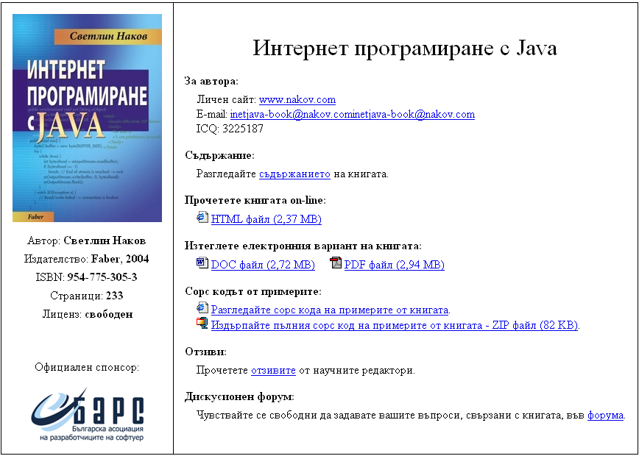
Exercises
See the image
InetJava-site.png
Create a Web site like the following:

